Slide 1

SIMATS SCHOOL OF ENGINEERING
SAVEETHA INSTITUTE OF MEDICAL AND TECHNICAL SCIENCES
CHENNAI-602105
IMAGE-CAPTION GENERATOR USING NATURAL LANGUAGE
PROCESSING(NLP)
BY-A.SHANMUKHA VINAY(192210313)
CSA1337-THEORY OF COMPUTATION WITH LOGICAL MODEL

Slide 2
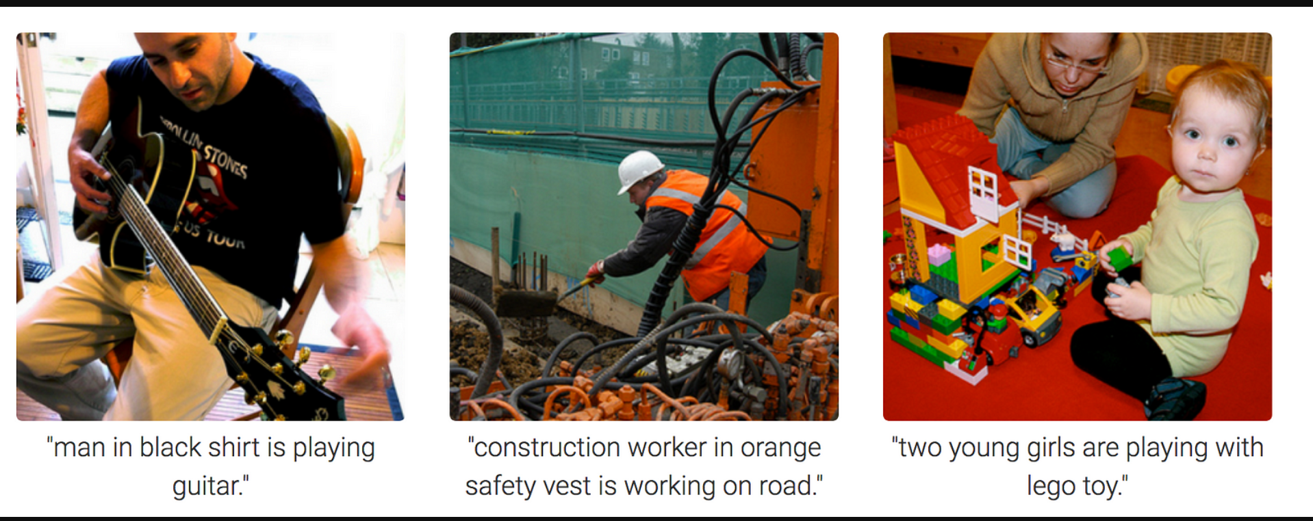
Introduction to Image-Caption Generator
Image-caption generation is an exciting field of natural language processing (NLP) that aims to automatically describe the contents of an image using natural language. This powerful technique has a wide range of applications, from assisting the visually impaired to enhancing image search and retrieval.

Slide 3

Understanding the Objectives
1
Describe Images
2
Accessibility
The key objective is to develop a model that can accurately describe the contents of an image using natural language.
Image-caption generators can improve accessibility by providing textual descriptions for the visually impaired.
3
Search and Indexing
Automated captions can enhance image search and indexing, making it easier to find and organize visual content.

Slide 4
Problem Definition and Algorithm
Problem Definition
Algorithm Overview
Key Challenges
The core task is to generate a natural language description (caption) that accurately and concisely describes the salient elements of an input image.
Typical approaches use deep learning models that combine computer vision and natural language processing techniques, such as convolutional neural networks and recurrent neural networks.
Accurately interpreting visual content and translating it into fluent, human-like language requires overcoming several challenges like visual understanding, language modeling, and multimodal integration.

Slide 5
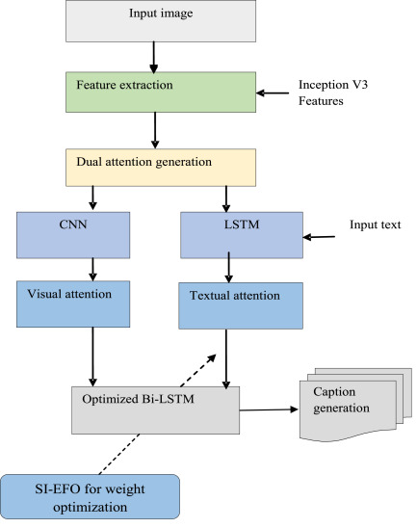
Experimental Evaluation
1
Evaluation Metrics
2
Benchmark Datasets
Common metrics include BLEU, METEOR, CIDEr, and SPICE, which measure the similarity between generated captions and ground-truth human-written descriptions.
Widely used datasets for training and evaluating image captioning models include MS-COCO, Flickr30k, and Visual Genome.
3
Model Comparison
Researchers compare the performance of different deep learning architectures and techniques to advance the state-of-the-art in image captioning.

Slide 6
Related Work
Early Approaches
Deep Learning Era
Multimodal Techniques
Initial image captioning approaches relied on rule-based systems and template-based generation, which had limited flexibility and generalization capabilities.
The advent of deep learning revolutionized the field, enabling end-to-end trainable models that can learn to generate captions directly from image data.
Recent advancements explore ways to effectively integrate visual and linguistic information, such as attention mechanisms and cross-modal representations.

Slide 7




Future Work
Improved Generalization
Developing models that can generate captions for a wider range of images, including those with unusual or complex content.
Contextual Understanding
Incorporating deeper understanding of scene context, commonsense reasoning, and cultural knowledge to generate more coherent and meaningful captions.
Interactive Applications
Exploring interactive captioning systems that can engage with users and adapt captions based on their feedback or specific needs.

Slide 8



Deployment and Real-World Applications
Web and Mobile Apps
Integrate the image-caption generator into web and mobile applications for visual content description.
Assistive Technology
Leverage the technology to aid the visually impaired by providing textual descriptions of images.
Multimedia Indexing
Automatically caption and index large image and video databases to enhance search and retrieval.

Slide 9

Conclusion
Powerful Technique
Ongoing Challenges
Image captioning is a powerful technique that can unlock new possibilities for image understanding and interaction.
While significant progress has been made, there are still many open challenges and opportunities for further research and development.
Exciting Future
The future of image captioning holds the promise of more intelligent, context-aware, and user-centric applications that can enhance our interaction with visual content.

Slide 10




Bibliography
Vinyals et al. (2015)
Xu et al. (2015)
MS-COCO Dataset
Hossain et al. (2019)
Show, Attend and Tell: Neural Image Caption Generation with Visual Attention
Show and Tell: A Neural Image Caption Generator
Common Objects in Context (COCO)
A Comprehensive Survey of Deep Learning for Image Captioning

Slide 11


